Slide 1
How do we watch net/wall games?
Tennis for example

Slide 2
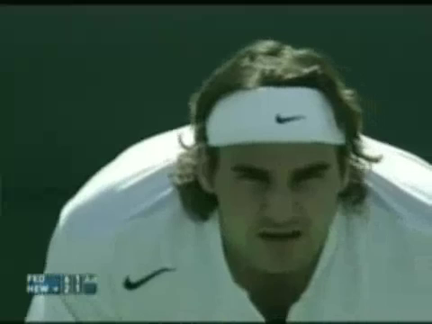

Slide 3
Game Performance Assessment Components*
Base - recovery position between skill attempts.
Decision making - making appropriate movements based on choices about what to do with the object or when defending space.
Cover - defensive movement in relation to object being played by an opponent or provide defensive help for player making a play on the ball.
Adjust - movement of player forward, backward or to side, as required by the play of the object in the game.
Skill execution - efficient performance of selected skills.
*adapted from Griffin, L. L., Mitchell, S. A., & Oslin, J. L. (1997). Teaching sport concepts and skills :
A tactical games approach. Champaign, IL: Human Kinetics.

Slide 4
4R’s and GPAI for Net/wall Games
Base
READ
RESPOND
REACT
RECOVER
Decision Making
Cover
Adjust
Skill Execution
Skill selection

